Slide 1

The Battle of Neighbourhoods
Pizza Tour

Slide 2
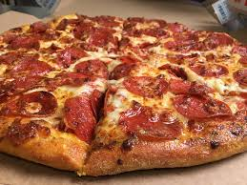
Introduction
For all those tourists who have always wanted to go on a pizza adventure in the US and dont know where to look, I propose a new solution by exploring pizza joint locations in major US cities.

Slide 3
Destinations
New York
Jersey City
Chicago
Boston
San Francisco

Slide 4
Methodology
Calculated the centre of all Pizza places
Calculated distance from each pizza place to the centre
Ranked the cities based on lowest average distances

Slide 5
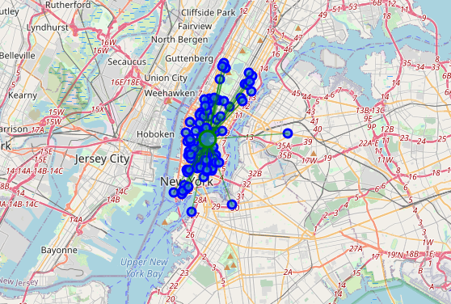
New York

Slide 6
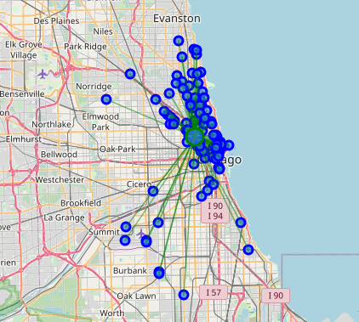
Chicago

Slide 7
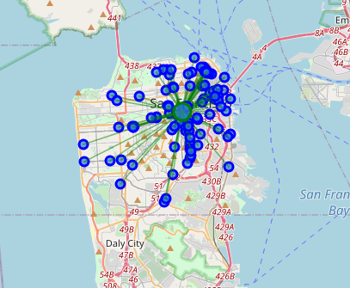
San Francisco

Slide 8
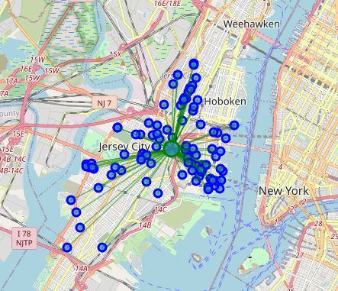
Jersey City

Slide 9
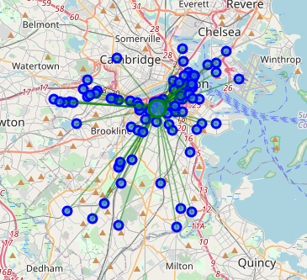
Boston

Slide 10
Results
1. Jersey City
2. New York
3. San Francisco
4. Boston
5. Chicago

